Slide 1
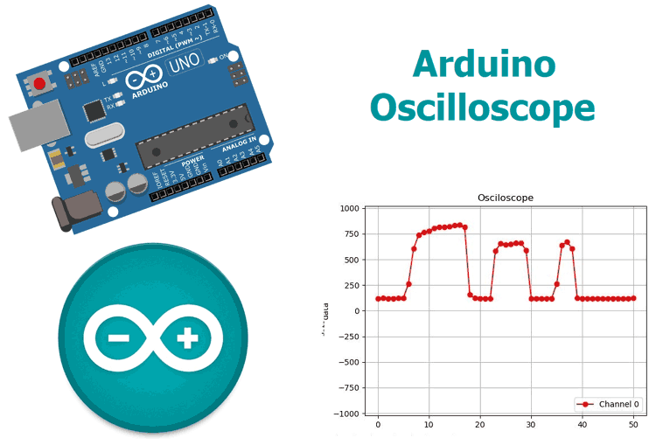
ARDUINO BASED REAL TIME OSCILLOSCOPE

Slide 2
INTRODUCTION
The Oscilloscope is one of the most important tools you will find on the workbench of any electronics engineer or maker. It is primarily used for viewing waveform and determining voltage levels, frequency, noise and other parameters of signals applied at its input that might change over time. It is also used by embedded software developers for code debugging and technicians for troubleshooting electronic devices during repair.

Slide 3
WORKING
There are two parts for this project;
1. The Data Converter
2. The Plotter
Oscilloscopes generally involve the visual representation of an analog signal applied to its input channel. To achieve this, we need to first convert the signal from analog to digital and then plot the data. For the conversion, we will be leveraging on the ADC (Analog to Digital converter) on the atmega328p microcontroller used by the Arduino to convert the Analog data at the signal input to a digital signal. After conversion, the value per time is sent via UART from the Arduino to the PC where the plotter software which will be developed using python will convert the incoming stream of data to a waveform by plotting each data against time.

Slide 4

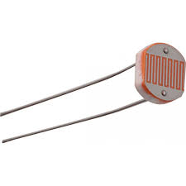
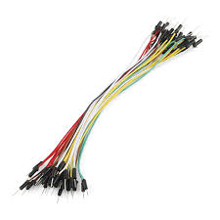
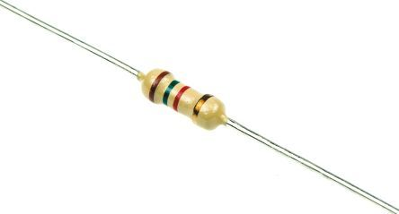
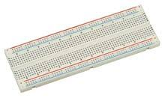
HARDWARE
SOFTWARE
Arduino Uno
Breadboard
10k Resistor (1)
LDR (1)
Jumper wires
Arduino IDE
Python
Python Libraries: Pyserial, Matplotlib, Drawnow

Slide 5
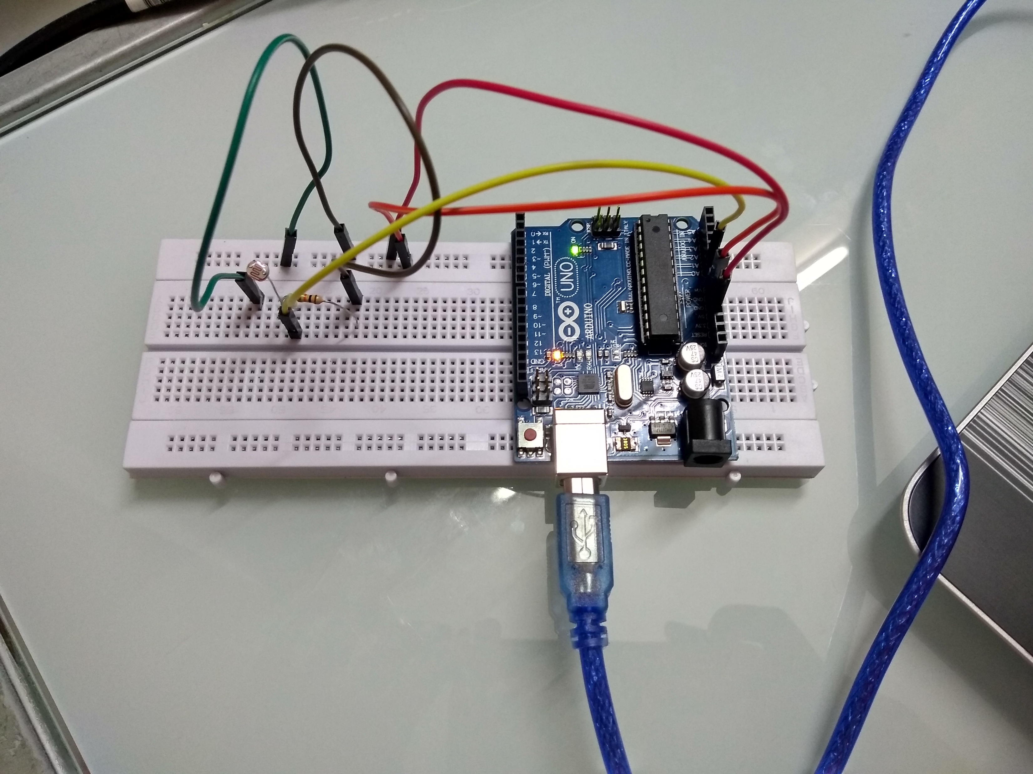
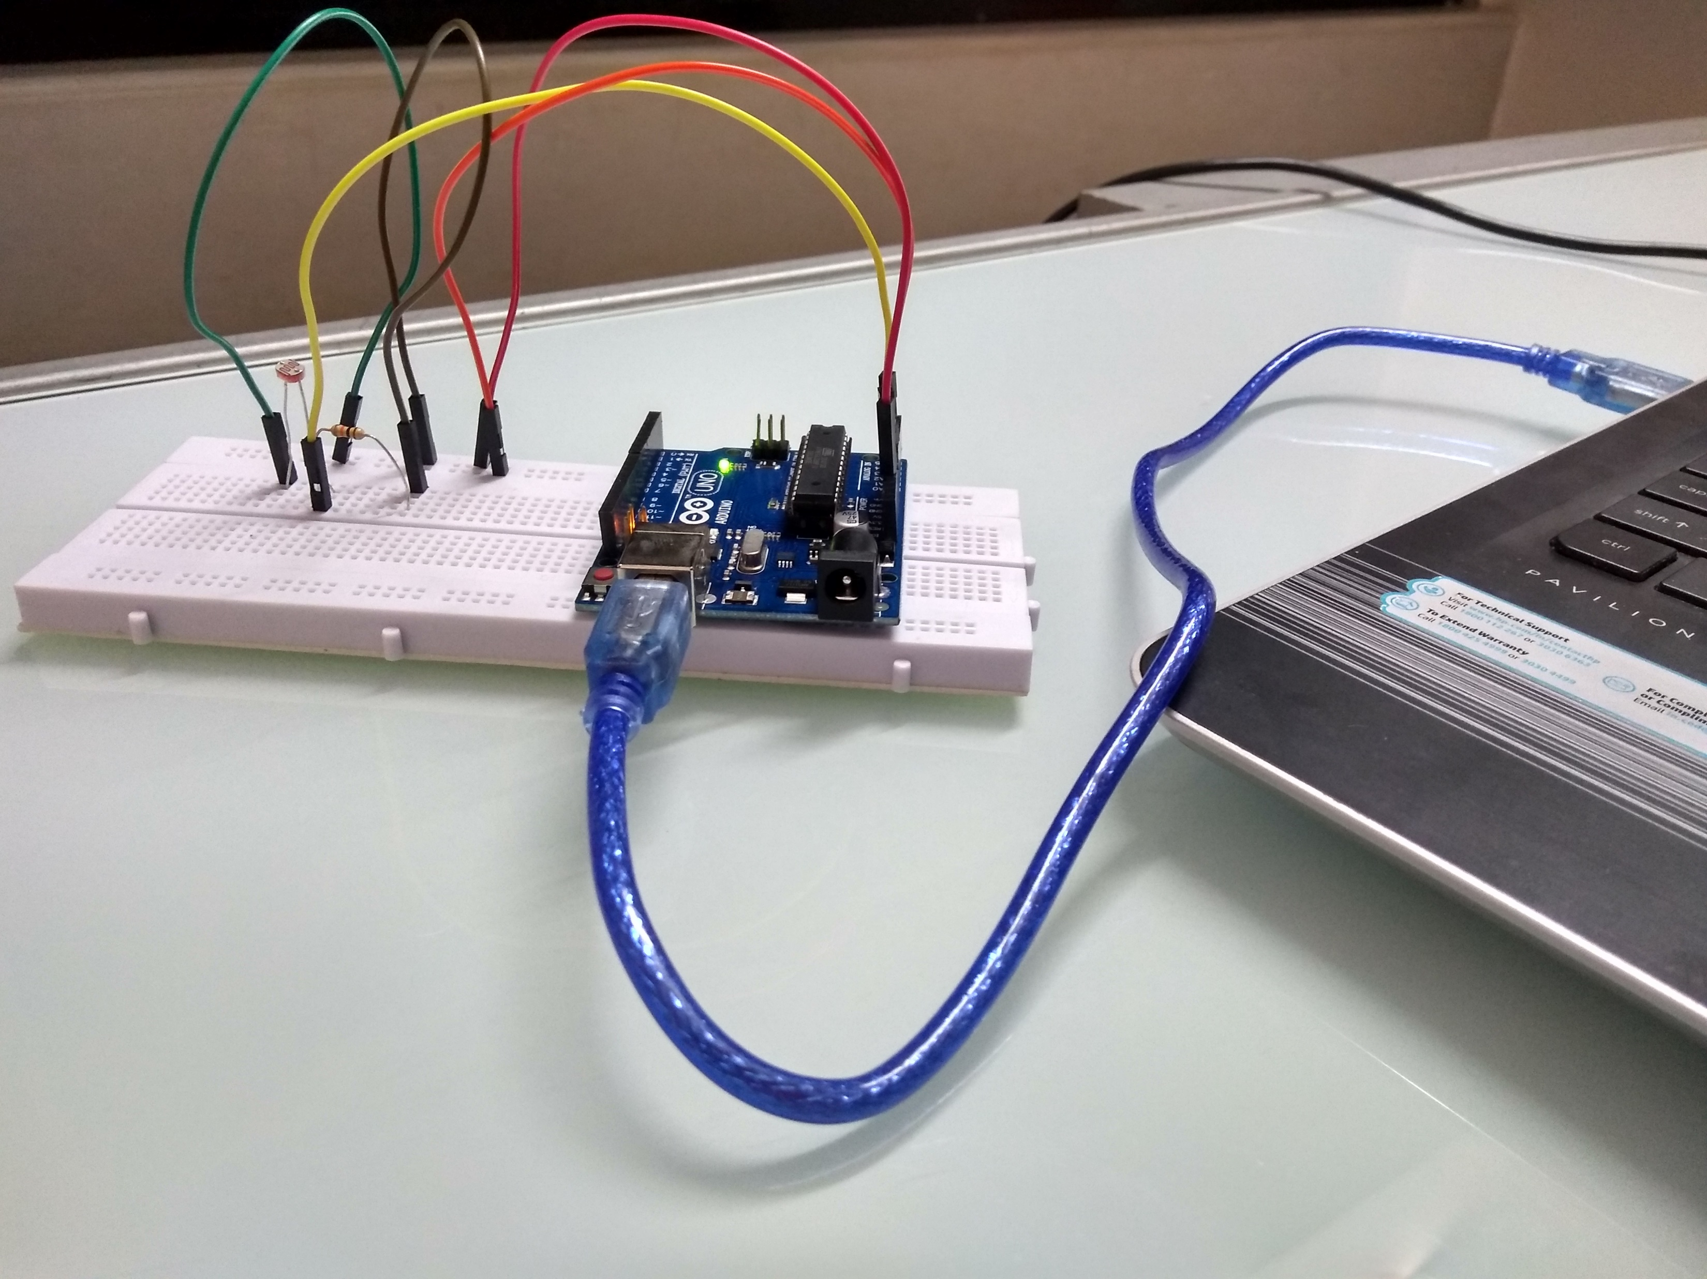
HARDWARE CIRCUIT
All we need to do is connect the signal to be examined to the specified Analog pin of the Arduino. However, we will be using the LDR in a simple voltage divider setup to generate the signal to be examined, such that the generated waveform will describe the voltage level, based on the intensity of light around the LDR.

Slide 6
CODES
We will be writing codes for each of the two sections. For the Plotter as mentioned earlier, we will be writing a python script that accepts the data from the Arduino via UART and Plots, while for the converter, we will be writing an Arduino sketch that takes in the data from the ADC and converts it to voltage levels which are sent to the plotter.

Slide 7
DEMONSTRATION VIDEO

Slide 8
FUTURE PROSPECTS
This mini-project of measurement eliminates the need to expensive oscilloscopes(Rs. 3000 – Rs. 10000) for temporary viewing of waveforms and determining voltage levels, frequency, noise and other parameters of signals applied at its input that might change over time. We can observe similar measurements using appropriate microcontrollers and software. The cost of the project was approximately Rs. 450.

Slide 9
SCALABILITY OPTIONS
There is no need of a complete development board integrated with a microcontroller(Arduino Uno) for specific functions utilized in the project.
For cost sensitive applications, we can develop a Printed Circuit Board around the microcontroller EM6580 from EM Microelectronic which is a
The EM6580 is a low power Flash 4-bit microcontroller coming in a small 8-pin SO package and working up to 0.4 MIPS. It comes with an integrated 4-bit ADC and 2 high drive outputs of 10 mA and it requires no external component. It has a sleep counter reset allowing automatic wake-up from sleep mode. It is designed for use in battery-operated and field-powered applications requiring an extended lifetime. A high integration level make it an ideal choice for cost sensitive applications. cost effective and compact flash MCU in SO-8/14 package.

